Slide 1


DataStories
Hosting Blueprint
Date: 21-May-2025
Primary: Anand Mallana, Priyank Chatterjee QA: Anil Nair
HIGHLY CONFIDENTIAL- FOR COMPANY INTERNAL USE BY AUTHORIZED PERSONNEL ONLY
Notes:
Ensure the titles are not duplicated. Please check the set of best practices.

Slide 2
Contents
01
Executive Summary
02
Hosting Integration Plans
Integration Overview
Integration process
Integration Milestones
Inventory and Assessment Summary
Locations Overview
Infrastructure Logical Diagram
High Level Integration Plan
Hosting Integration Considerations
Risk and Dependencies
Key Assumptions
03
Budget
04
Website Migration
Hosting Integration Budget Details
Website Migration Plan
05
Appendix
Success Criteria
Support matrix
Contacts
Additional Materials

Slide 3
Executive Summary
Hosting Integration Overview
Hosting Integration Process & Timelines
Hosting Integration Milestones
Notes:
Ensure the titles are not duplicated. Please check the set of best practices.

Slide 4
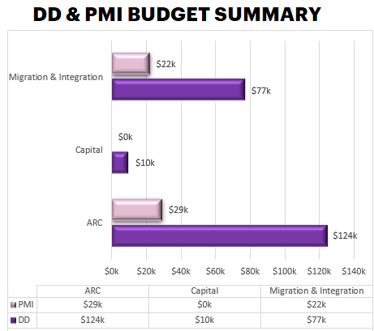
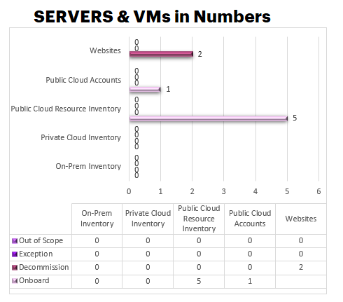
Hosting Integration Overview
TYPE | DESTINATION
Public Cloud subscriptions | AWS account to be moved to Accenture platforms.
Website Hosting | 3rd party hosted sites to be decommissioned. AWS hosted sites to be retained.
SERVICES
In USD $

Slide 5
Hosting Integration Process & Timelines
Inventory
Blueprint
Build/create destination hosting & Training
Migration/
Integration & compliance
operations
Complete hosting compute & storage inventory
Decide on disposition of inventory VMs and storage.
Apply SOC tools & remediate open vulnerabilities. This is in scope for Security workstream.
Based on inventory, write hosting integration blueprint
Blueprint details retention and decommissioning.
Based on blueprint:
Build private cloud per Accenture standard as required.
Train project for CMO onboarding as needed.
Create public cloud accounts as needed.
Create local hosting exception if required.
Private cloud migration
Public cloud integration
Local hosting exception
Web hosting integration/migration per blueprint
All the above must be compliant with Accenture Security standards
Hosting compute and storage in end state per Accenture standard.
UAT complete.
SOC dashboard training (compliance with all IS policies) complete.
Support RACI agreed by stakeholders.
Close +1 Month
Hosting Inventory
Close +2 Months
Hosting Blueprint
Close +4 Months
Infrastructure Build
Close +6 Months
Migration
Testing
Decommissioning

Slide 6
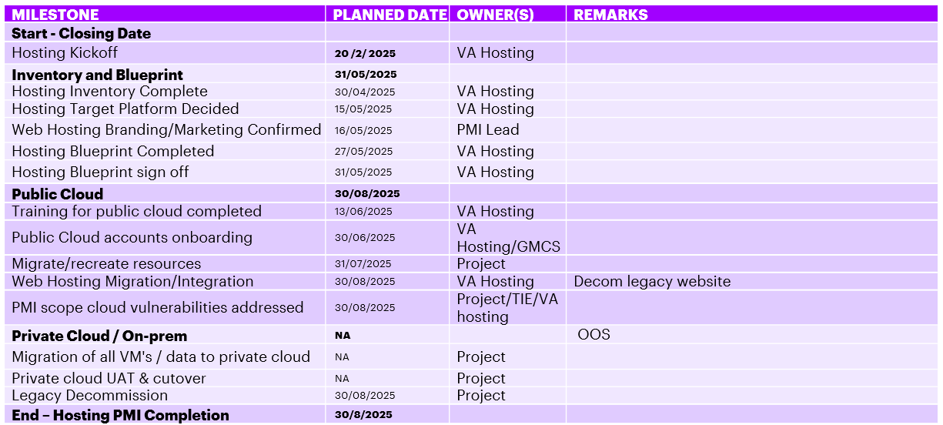
Hosting Integration Milestones

Slide 7
Hosting – High Level Migration Plan
AWS
Phase 1 (GMCS Landing Zone)
Phase 2 (GMCS Accounts)
AWS
1 account
1 AWS account in scope to be onboarded to GMCS’s landing zone
Remote access to the virtual machines via Accenture approved VPN (VAPoD)
DataStories + V&A Hosting team + VA remediation team + GMCS team to secure and harden onboarded hosting environment
GMCS migration team to work with DataStories to redesign, redeploy, and/or migrate resources to Phase 2 outside of PMI timeline
Change ownership of cloud accounts
Address any vulnerabilities
2 new AWS accounts to be spun up through GMCS (non prod & prod)
Migrate existing onboarded AWS account resources to newly spun up GMCS provided AWS account to leverage Accenture’s discount and enable GMCS monitoring, alerting, logging, and remediation services
GMCS migration team to work with DataStories throughout both phase 1 and phase 2, to understand, redevelop/redesign infrastructure to use exclusively Accenture approved services and applications
Remote access to virtual machines via Accenture’s Global Protect
Bastion to be used for secure SSH and RDP access to virtual machines
Align with the GMCS architecture standards

Slide 8
Hosting Integration Plans
Hosting – Existing Hosting
– High Level Integration Plan
– Reference Architecture
Notes:
Ensure the titles are not duplicated. Please check the set of best practices.

Slide 9



Existing Hosting - Overview
https://demo.datastories.com
669412377329
https://discover.datastories.com
https://datastories.com/
Internet
IP Filtering
Remote Access - DS Users
Website access
DS laptop

Slide 10
Hosting – High Level Integration Plan
DataStories has one AWS account. This account will be onboarded on Accenture GMCS platform.
556008695729
Current website (GTM - https://datastories.com/) is hosted on AWS
Additional websites (https://demo.datastories.com and https://discover.datastories.com ) are hosted on a third-party platform “Unbounce”. These will not be retained.
The PMI team is currently in discussion with the deal team regarding WiredUP. A separate blueprint will be created for this.
The accounts will be segregated based on production and non-production environments when moving to GMCS core, or as finalized between the GMCS and DS team.

Slide 11

Reference Architecture
Accenture GMCS LZ
669412377329
443
https://datastories.com/
Internet
Target Reference Architecture
Accenture standard VPN
Remote Access - DS Users
GTM app access
Accenture laptop

Slide 12
Budget & Costs Estimates
Hosting Integration Budget Details
Notes:
Ensure the titles are not duplicated. Please check the set of best practices.

Slide 13
Hosting IT Integration Budget Details
Report Date
 | DD | PMI
Total Annual Run Costs (ARC) | $124k | $29k
Total Capital Expenditure | $10k | $0k
Migration & Integration Costs | $77k | $22k
Item | Quantity | Opex | Comments
AWS | 1 | $26,542 | Onboard to GMCS
10% contingency |  | $2,654
Total |  | $29,196
Note :
All the costs are in USD.
The Estimate is based on the number of servers, and configuration shared in the Hosting Inventory by DS IT team.
Hosting blueprint excludes application license costs and application installation efforts.
The DD costs are for project Praire as we do not have separate set of costs for each sub entity available.
Current PMI costs are only for Datastories. PiP and WiredUP related costs/resources are not included in this blueprint

Slide 14
Website Migration
– Website Migration Plan
Notes:
Ensure the titles are not duplicated. Please check the set of best practices.

Slide 15
Website Migration Plan - NA
The existing 2 public websites hosted on unbounce, previously used for marketing campaigns will be decommissioned.

Slide 16
Appendix
– Hosting Integration Considerations
– Risk and Dependencies
– Key Assumptions
– Hosting Integration Execution Success Criteria
– Operations Support Matrix
– Hosting Integration Out of Scope
– Accenture Security Standards
– Contacts
Notes:
Ensure the titles are not duplicated. Please check the set of best practices.

Slide 17
Hosting Integration – Considerations
Integration Plan
AWS Account | This account will be onboarded as is on the GMCS landing zone. Moving resources to GMCS core will be a post PMI activity basis the finalization between project and GMCS post PMI.
Application Architecture | Available in the hosting folder

Slide 18
Hosting Integration - Risk and Dependencies
Risk and Dependencies
Information Security | Accenture standards will be followed for any applications vulnerabilities and their remediations.
Accenture Standards | DS to review the Accenture Information Security Standards for complete compliance. Refer the complete list standards in Appendix. Accenture laptops and enterprise IDs required for Accenture SSL VPN Accenture operate a Firewall Approved Services Matrix (FASM) which dictates what ports can and can‘t be opened between various devices/servers, which may not match PiP rules.
Application disposition

Slide 19
Key Assumptions
Assumptions
Overall assumptions | DS mostly utilizes PaaS & SaaS, minimal infrastructure is available OS and VM infrastructure level support will provide by DS IT team and GMCS. Applications and DB will be supported and managed by the DS IT team.
Website support | Marketing team and DS IT team will be managing the websites
Infrastructure | OS level patch and vulnerability management are supported by DS IT team and GMCS. Vulnerability related to applications will be remediated by DS application owner. The environment will be accessed by Accenture personnel only.
Information Security | Remote access to the servers via Accenture network standard VPN. All firewall rules would be governed by Accenture Security FASM (Firewall Approved Security Matrix).
Back-up and DR | Existing configured backup and DR to be utilized.

Slide 20
Inventory and Assessment Summary
Qty | Type of Resources | Location | Hosting type | Disposition | Destination | Remark
1 | cloud account | AWS | Public cloud | Migrate | AWS | Onboard account to (GMCS)
2 | Website | Unbounce | Unbounce | Decommission | WPE | Decommission public website resources on unbounce
The inventory provided by DS has been uploaded into the ISIT Hosting folder, was reviewed and dispositions assigned for each server with input from the by DS IT team. This is the basis for of hosting scope.

Slide 21
Hosting Integration Execution Success Criteria
The project will be deemed successful when DataStories confirms successful completion of:
Servers hosted in ACN approved Cloud platforms are accessible per the blueprint
Successful UAT of applications after onboarding
Remote access solution successfully tested
Environment is being monitored and SOC compliant
The legacy AWS account has been onboarded on Accenture standard platforms
Decommission legacy accounts/resources (Unbounce).

Slide 22
Hosting Operations Support Matrix
Hosting | Provider | Location | Owner | Supporting team
Public Cloud Hosting | AWS |  | GMCS/ Project | Cloud infrastructure will be supported by GMCS. OS and VM level support will provide by GMCS. Application/DB will be supported and managed by DS IT team and application owners.

Slide 23
References

Slide 24
Hosting Integration Out of Scope
Out of Scope
Application installation, configuration and patching effort. With application workstream.
Application software licensing cost. Application workstream.

Slide 25
Accenture Security Standards
Project_Name to comply with Accenture security standards as detailed on the Protecting Accenture website and the Acenture Policies website, some of which are shown below:
Policy 56
Enterprise Security Standards
Access Control Standard
Identification and Authentication Standard
Logging and Auditing Standard
Microsoft AD Security Standard
Remote Access Standard
Remote Console Access Standard
Encryption Standard
Data Classification and Protection Standard
SSL VPN Standard
Global Firewall Approved Services Matrix
Backup Security Standard
Accenture Information Security Public Cloud Approved services
Accenture Public Cloud IaaS Security Standard
Accenture Public Cloud PaaS and SaaS Security Standard
AWS Cloud Security Configuration Standard

Slide 26
Contacts
Workstream | Owner
PMI Lead/Assistant | roman.pantin@accenture.com
CRR | joefrey.c.pielago@accenture.com
CSI | ash.shukla@accenture.com
Hosting | priyank.chatterjee@accenture.com
MCP | shashidhar.pr@accenture.com
TIE | syed.tariq@accenture.com
Applications | anita.gajapathy@accenture.com
Network | anita.gajapathy@accenture.com
CDP | pallavi.attavar@accenture.com

